Slide 1
Zine pedagogy: zines in the classroom

Slide 2
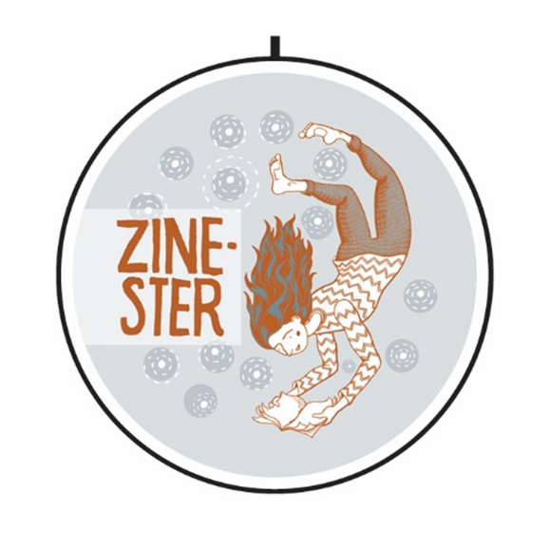
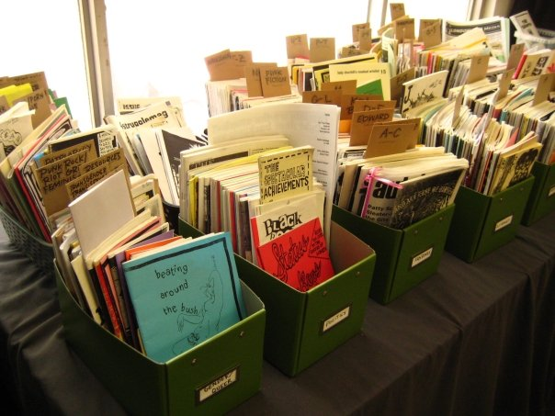
What’s a zine?
A zine is the colloquial term for a little magazine. These are independently amateur publications that resemble pamphlets in styling and their materiality.
A zine is a small booklet of writing, drawings, comics, collages, photographs, and anything else you can think of! Some zines include extra fun things like buttons, stickers, and patches.
The most common type of zines are made with 8x11 paper that is folded in half and side-staple bound with a saddle stapler.
A creator of a zine is called a “zinester”

Slide 3
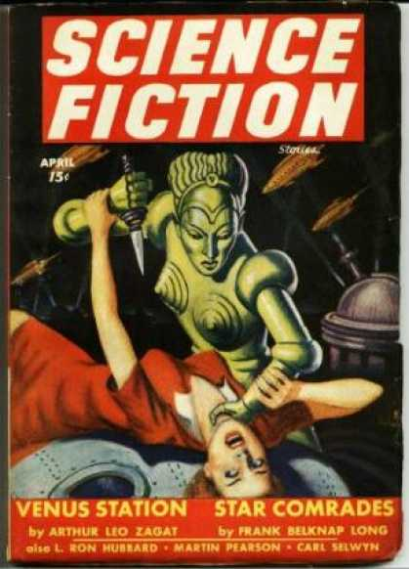
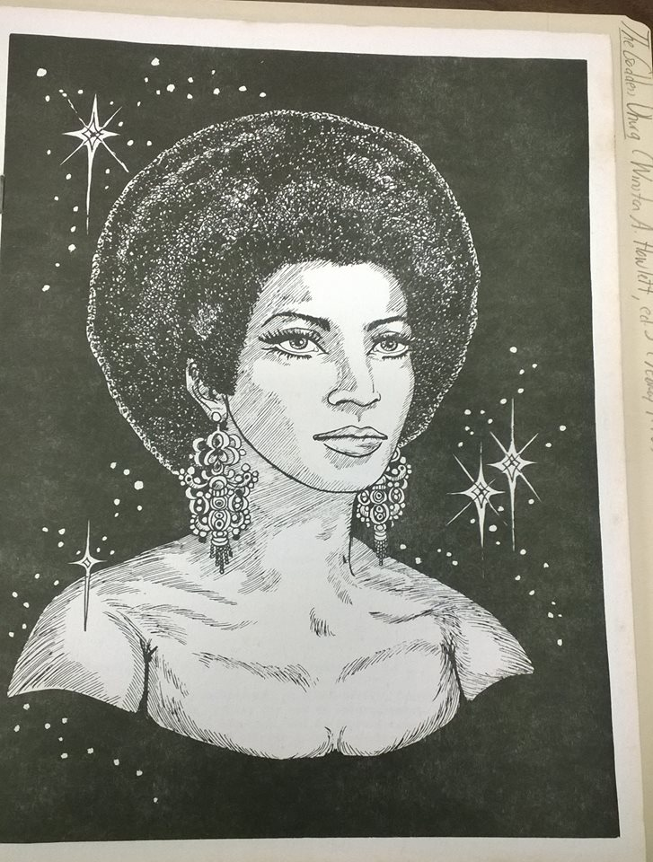
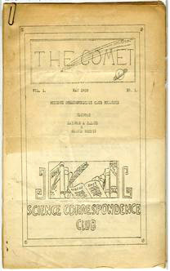
The history of zines
Most scholars that study zines and radical publishing methods place the beginning of zines in the 1930’s with the rise of Science Fiction.
Pulp magazines, like the most popular publication Amazing Stories, asked readers to send in letters and contribute to the dialogue of SF.
Fans began to send letters to Pulp magazines, which in turn, they sent letters to other fans, and finally they created their own little magazines.

Slide 4
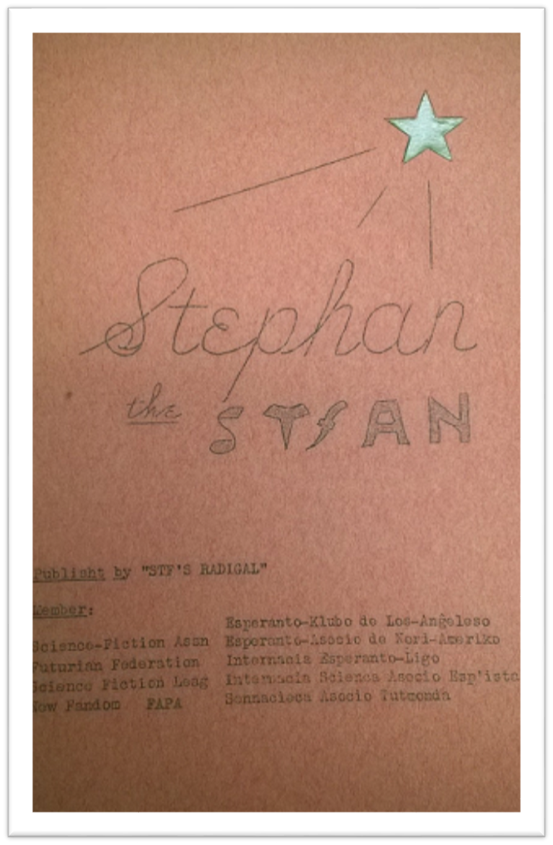
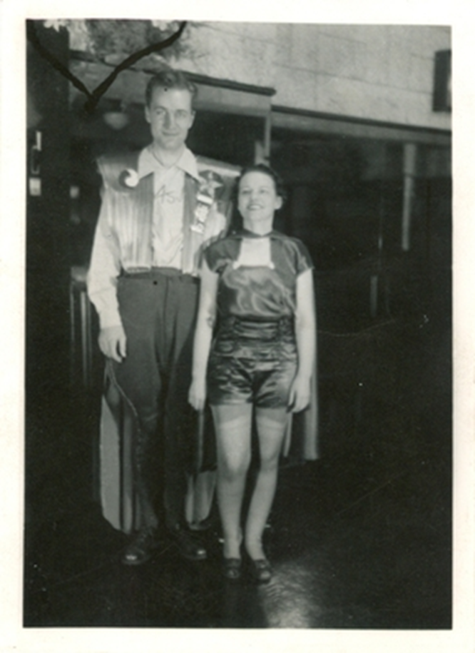
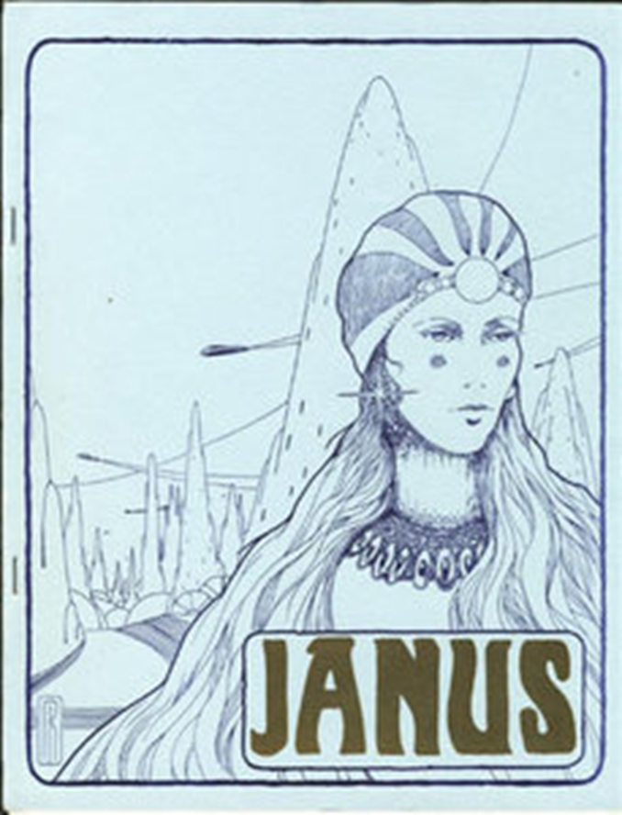
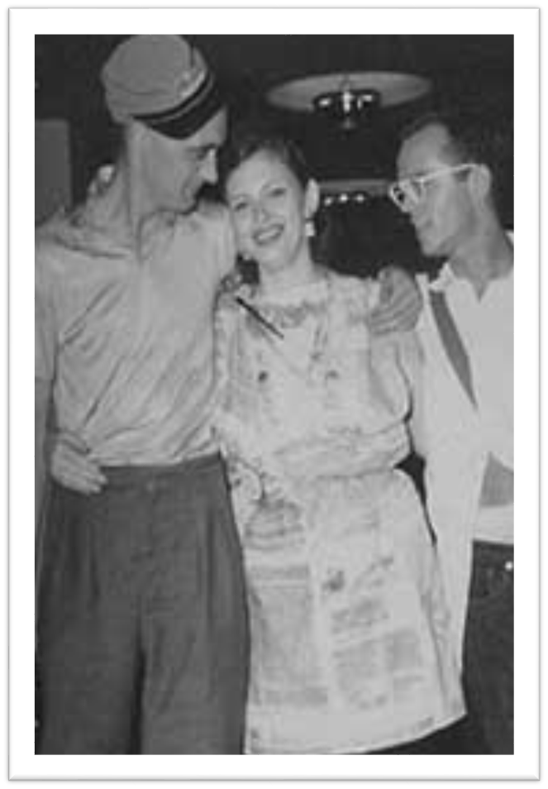
Zines as community Dialogue
The first zines were created by fans within the Science Fiction community. Fanzines became a document that recorded and charted the narratives within the fan community.
Specific languages used by fans were printed within these fanzines. Often, a typo was made within the fanzine, and fans chose to keep that word within their community.
Science fiction was mostly a male-dominated sphere that limited access to women in SciFi clubs and leagues. However, many women edited and contributed to SciFi fanzines.

Slide 5
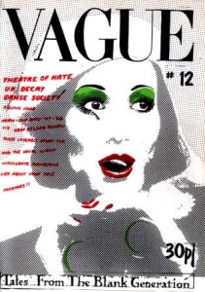
Transformation of zines
In the 1960’s SciFi fanzines continued to be a popular underground media.
Many poets began to self-publish their works, in booklets styled like zines, ‘chapbooks.’
Radical publishing methods were adopted by other counter culture communities, namely, the punk scene in the 1970’s.
Punk fanzines like Sniffin Glue, and Vortex were created in response to the growing counterculture of punk rock music. Punk rock fanzines were created with a DIY-ethic that resisted dominant culture.

Slide 6
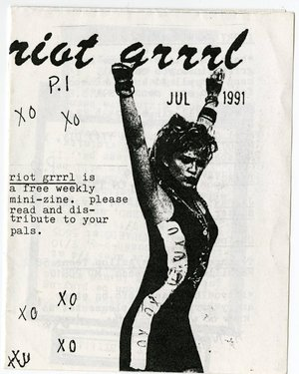
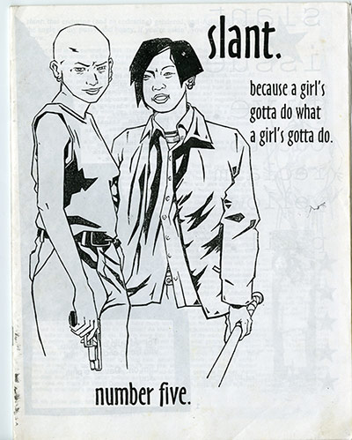
Riot Grrl zines
In the early 90’s, a new genre of music emerged that was explicitly feminist, sex-positive, and radical: Riot Grrrl. This genre of music and collective of feminists created their own genre of zines to resist heteronormative, patriarchal, and oppressive structures that attempted to define women.
https://www.youtube.com/watch?v=uGZhJyWh-RY

Slide 7
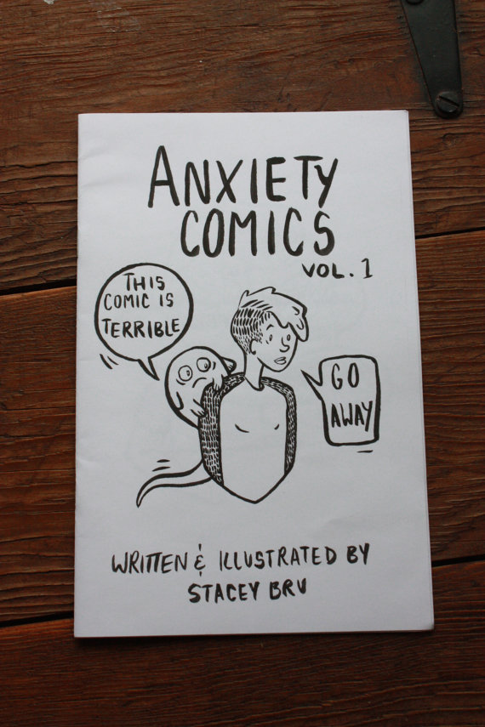
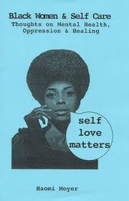
Zines of the ‘now’
Contemporary zines are more intersectional, radical and expressive.
Contemporary zines are sometimes divided within the categories:
-Perzine: a personal zine written from the perspective of the zinester. Often these zines tackle issues of gender, sexuality, trauma, and identity.
-Foodzines: zines about food-ways, recipes, dietary preferences, etc.
-Fanzines: SciFi & music zines!

Slide 8
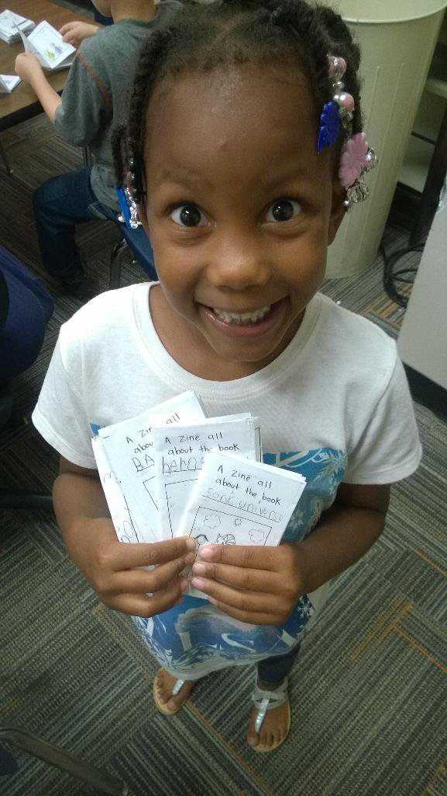
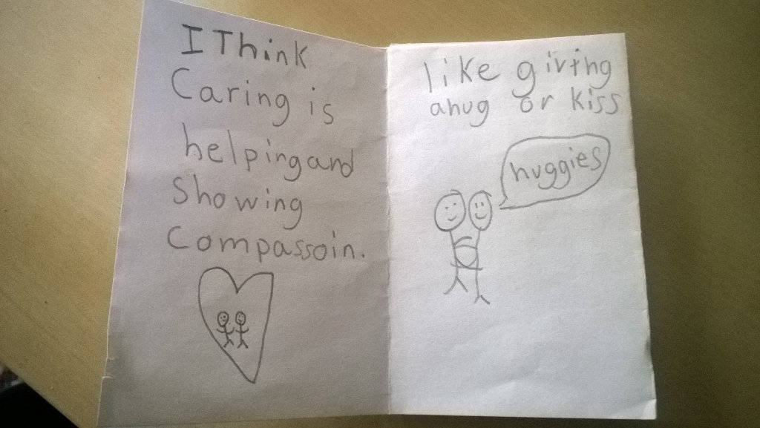
So how can zines be used in the classroom?
Zines can be used as a platform for creative writing that allows students to independently publish their own narratives- without editing.
Students have the ability to write about their own personal experiences in their own vernaculars.
Students can write about their own personal experiences, with out being harshly criticized or judged.
Students are given the agency to share and distribute their work- creating their own publishing communities.

Slide 9
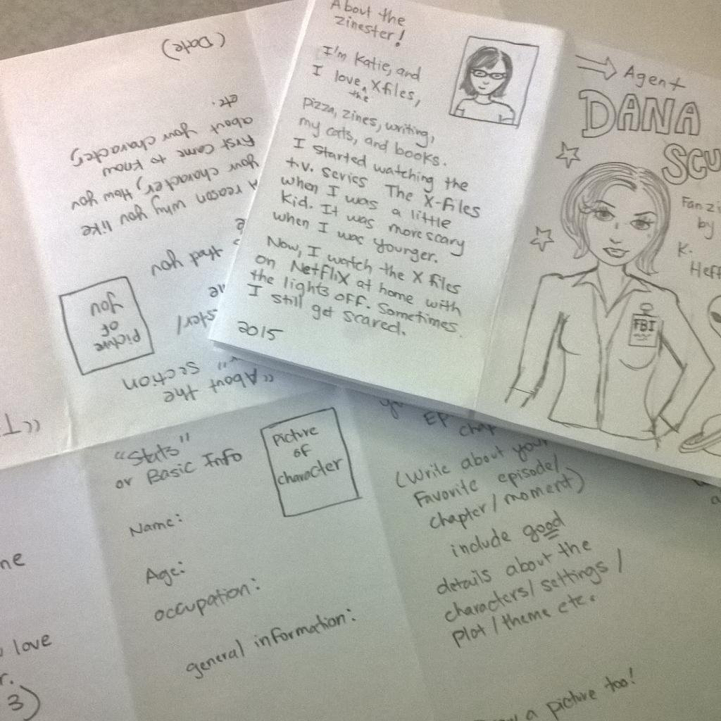
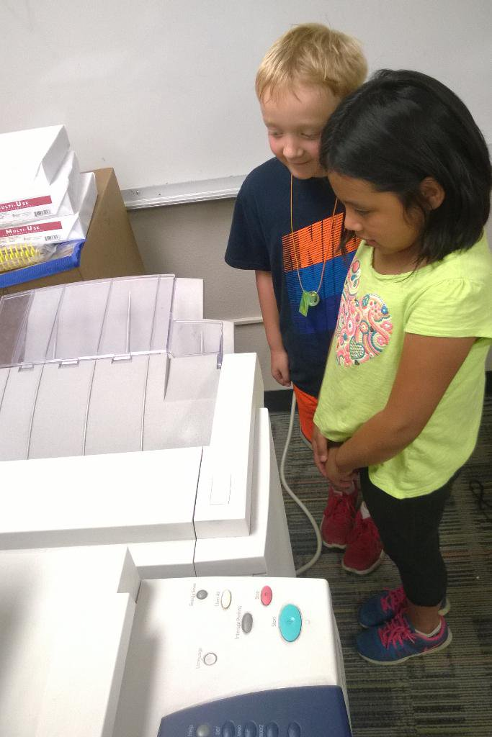
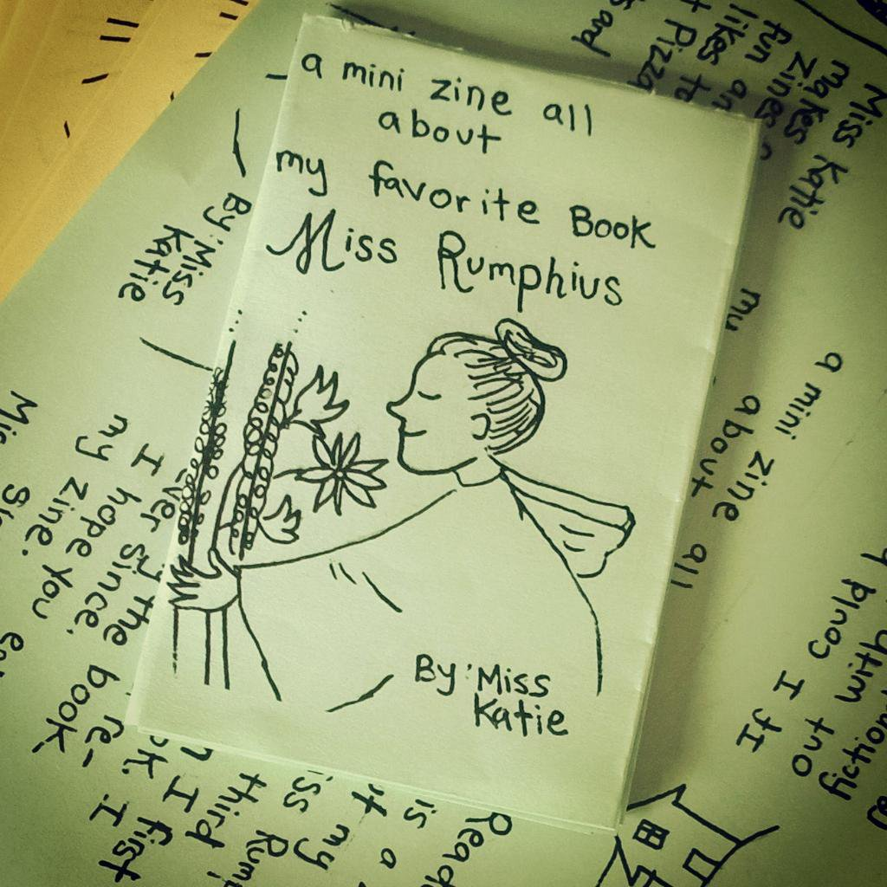
Instabook demo!

