Slide 1
Head-Mounted Display Visualizations to Support Sound Awareness for the Deaf and Hard of Hearing
Dhruv Jain et al. 2015
https://homes.cs.washington.edu/~djain/
Notes:
Upon googling the first author’s name, I see that he is at the University of Washington, but looking at the paper in 2015, he was at the MIT Media Lab for his Master’s degree.
On his website, he says he is making new communication mediums for deaf people

Slide 2
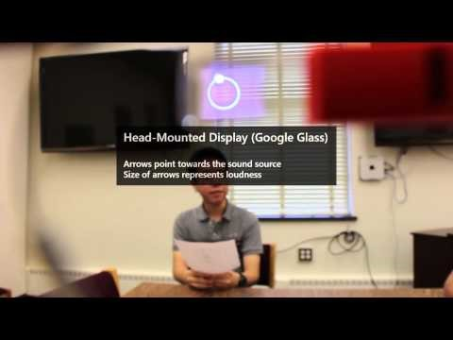
Notes:
First, I will play a video of the system so that everyone has some context

Slide 3
Introduction
People who are Deaf or Hard of Hearing (DHH) may rely on speechreading
Have to know where to look
Prior visual aids focus on alarms, doorbells, etc.
Not on conversational partners
Authors explore a head mounted display (HMD) approach to help people follow along

Slide 4
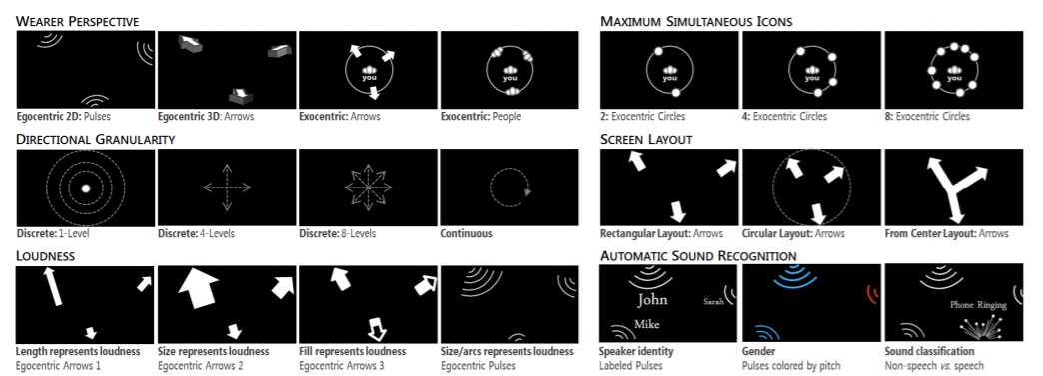
Explored several design dimensions
Notes:
Note – only submit slides to class. I am technically not requesting permission from the authors to do this right now, so this is just for in class.

Slide 5
Introduction
Design probe study with 24 DHH
Exploratory study with HMD with 4 DHH
Notes:
Purposely leaving results out for now because I will be talking about them in detail as I get to that point in the paper

Slide 6
Background: Communication Strategies and Sound Awareness
Use gestures, two-way note taking, speech reading
Different communication behaviors:
Maladaptive – avoiding conversation
Adaptive – can you repeat that? Explain hearing loss, repositioning
Using hearing aid or cochlear implant does not mean no speechreading
Useful to identify sounds in the environment
This is left for future work

Slide 7
Background: Hearing Aids and Cochlear Implants
Employ digital signal processing
Noise suppression, dynamic gain control, directional microphones
Amplify sounds in the direction of the listener
But doesn’t help with localization

Slide 8
Background: Visual and Tactile Sound Awareness Approaches
Wrist worn localization by Kaneko et al.
But requires people to look away from conversation
Haptics are promising, but nascent, they are exploring audio
Automatic Speech Recognition
Far from a solved problem
Sony created Access Glasses for the movies
But the captions are prewritten
HMD with interpreter
Visual competition with visual surroundings and interpreter
Notes:
Notice how all the work is addressed, but they explain why their approach is addressing existing challenges

Slide 9
Background: Augmented Reality
Visual imagery overlays real-world objects
While plenty of work in HMDs
Could not find guidelines for displaying peripheral visual cues

Slide 10
Design Goals
Localize sound
Glanceable
Responsive
Augment, not substitute
360 degree sensing
Adaptable
Created 8 high-level design dimensions
Notes:
Using related work and their own experience with people with hearing loss, came up with these design goals
Speaker recognition, real-time captions, topic analysis, descriptive conversational statistics, emotion interfaces

Slide 11
1. Wearer Perspective
Notes:
2d vs 3d in egocentric. Exocentric you are represented, ego is first person

Slide 12
2. Directional Granularity
Notes:
1 – shows sound is occurring, not location, 4 option, 8 option (45 degrees), continuous is literally anywhere

Slide 13
3. Loudness
Notes:
Showed four different types of loudness, length, size, fill, size of arcs

Slide 14
4. Sound Indicator Icons
Egocentric: Explored pulse, arrow, and finger (not shown)
Exocentric: Explored arrows, people, and circles

Slide 15
5. Maximum Simultaneous Icons

Slide 16
6. Screen Layout

Slide 17
7. Conveying Sound Source
Not pictured, but whether arrows:
Point toward sound source (toward speaker)
Point away from sound source (away from speaker)

Slide 18
8. Automatic Sound Recognition
Notes:
Names, gender, classification of speech versus non speech

Slide 19
Study 1: Design Probe and Evaluation
24 people (12 female)
23-76 years old (average 38.1)
20 profound hearing loss, 4 at least moderate hearing loss
12 congenital hearing loss, 7 early childhood
7 cochlear implants, 8 hearing aids
19 used lip-reading

Slide 20
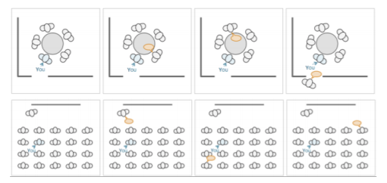
Study 1: Design Probe and Evaluation
iPad showing a powerpoint presentation
Show the breadth of ideas
Medium fidelity Google Glass application
Show the proof of concept
Semi-structured interview
9 verbal
15 two-way chat
Notes:
First author is hard of hearing, and picked two difficult scenarios. Meeting table the classroom

Slide 21
Study 1 Procedure
Part 1: demographics, challenges, how participants address them, background with technology
Part 2: Showed glass application and PowerPoint
Asked for open ended feedback
Asked which scenarios were on glass to assess engagement
Asked for ideal designs
Changed the ordering of each type of design to avoid bias
Notes:
I can talk about counterbalancing in class
Video and audio recorded these sessions, two researchers coded (or labeled) all of the interviews
Tabulated people’s preferences for each type of design

Slide 22
Study 1, Part 1 Findings
Participants confirmed group conversation issues
Use hearing aids, captioning services, or interpreters
Pen and paper, two-way chat programs
Avoid conversations with hearing people and groups
Technology:
Smartphone, tablet, laptop, CART, UbiDuo
Desire ASR on mobile phone

Slide 23
Study 2, Part 2 Findings
All participants liked the idea
17 want to know who is speaking and direction of sound source
4 said that even sound source direction and lip reading would be insufficient

Slide 24
1. Wearer Perspective
Split between egocentric and exocentric
Split between 2D and 3D
Notes:
Exocentric – easier to locate others with respect to oneself
Egocentric – less cluttered interface
2D – simpler interface
3D – increased realism

Slide 25
2. Directional Granularity
14 chose continuous, 5 chose 8 level
3 chose 4 level, 1 chose 1 level
Notes:
The more specific, the better

Slide 26
3. Loudness
Majority preferred egocentric pulses that vary in size
Notes:
Showed four different types of loudness, length, size, fill, size of arcs

Slide 27
4. Sound Indicator Icons
Egocentric – 14 chose pulses
Exocentric – 9, 7, 7 respectively

Slide 28
5. Maximum Simultaneous Icons
This should be customizable
but likely 4 people

Slide 29
6. Screen Layout
10 chose rectangle, 9 chose circle, 3 split between the two
Notes:
Aesthetic for rectangle, easier to understand for circle

Slide 30
7. Conveying Sound Source
Not pictured, but whether arrows:
Point toward sound source (toward speaker)
Point away from sound source (away from speaker)
17 chose outward because it shows where to look.

Slide 31
8. Automatic Sound Recognition
Almost all participants wanted all of these options (except gender)
Notes:
Names, gender, classification of speech versus non speech

Slide 32
Study 2: Proof of Concept System
Created application with Google Glass and 64-microphone array
Based on first study, built egocentric pulses and exocentric arrows
Notes:
Interpreted all co-occurring sounds, picked four highest intensity sounds and sent those to the google glass

Slide 33
Study 2: Procedure
Four participants (2 female)
Ages 26-42 (average 35)
3 profoundly deaf since birth, 1 severe hearing loss in both ears since early childhood
3 employed lip reading sometimes
Sat at meeting table wearing glass
Person walked around room talking, then had scripted “meetings”
Notes:
2-person conversation at ends of table
4-person around table, but one person moved behind participant
Then had conversation with the four members
From Shawshank Redemption and Ghostbusters

Slide 34
Study 2: Results
Felt this would be helpful in at least some contexts
Hard to look at the glass and lip-read at the same time
Hard to attend to hearing aid and glass at the same time
Useful:
In public setting and someone is trying to get their attention
Social group settings
3 participants preferred arrows, 1 had no preference

Slide 35
1. Wearer Perspective
Either can be used

Slide 36
2. Directional Granularity
Use continuous, 8 level worst case
Notes:
The more specific, the better

Slide 37
3. Loudness
Egocentric pulses
Notes:
Showed four different types of loudness, length, size, fill, size of arcs

Slide 38
4. Sound Indicator Icons
Use pulses with egocentric
No clear pattern for exocentric

Slide 39
5. Maximum Simultaneous Icons
4-5 users, but should be custom

Slide 40
6. Screen Layout
Screen indicators should be in periphery, not the center
Notes:
Aesthetic for rectangle, easier to understand for circle

Slide 41
7. Conveying Sound Source
Not pictured, but whether arrows:
Point toward sound source (toward speaker)
Point away from sound source (away from speaker)
Point arrows outward

Slide 42
8. Automatic Sound Recognition
Employ these, not gender
Notes:
Names, gender, classification of speech versus non speech

Slide 43
Limitations
Should get a larger sample
Did not show an equal number of all design dimensions
More exposure to egocentric and outward designs
Lab study, not a deployment study

Slide 44
Discussion
Importance?
Credibility?
Novelty?
Applicability?
Generalizability?
Scalability?
Assumptions?
Readability?

